Slide 1

Python Web Basics
Course Introduction
SoftUni Team
Technical Trainers
Software University
https://softuni.bg/

Slide 2
Table of Contents
Course Objectives
Training and Team
Course Organization
Course Infrastructure
Evaluation Criteria
2

Slide 3
Have a Question?
sli.do
#python-web

Slide 4

Course Objectives

Slide 5
Python Web Basics Objectives
Working with HTTP Requests
Get familiar with the MVC architecture
Get familiar with the basic Web concepts
Working with SQL
Build servers
Build the foundations of Django web development
5

Slide 6
Practical Programming Exam
Exam – 4 hours
1 practical problem - creating simple CRUD application
6

Slide 7
Theoretical Exam
You will have 30 minutes once you enter
Multiple-choice with 1 correct answer
Test will be in English
Automated quiz system
Available on the day of the practical exam
You can submit your answers just one time
7

Slide 8

The Team

Slide 9
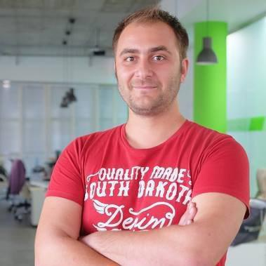
Doncho Minkov
Senior Full Stack Developer in SoftUni
10+ years in IT
8+ years of experience as a
Technical Trainer @ Telerik Academy
Front-end developer by heart
Software developer by need
Experience with all popular mobile platforms
Android, iOS, Windows
Fluent in Node.js, .NET, Angular, Java, C++
"30 under 30" – Forbes 2017 - Education

Slide 10

Course Organization

Slide 11
Python Web Basics Course
15-Sept-2020
01-Nov-2020
16-Dec-2020
Python Advanced
6 weeks * 2 times / week
12 credits
Start: 15-Sept-2020
Theoretical Exam: 01-Nov-2020
Final exam: 01-Nov-2020
Re-Take Exams
Theoretical Retake Exam: 16-Dec-2020
Final Exam Retake : 16-Dec-2020

Slide 12


SoftUni Certificate
Practical Exam 100%
Homework 5%
Evaluation
12

Slide 13
CPE Certificate
Theoretical Exam 100%
Evaluation
13

Slide 14


Course Web Site, Forum and FB Group
Official web site:
Softuni Python Community group:
https://softuni.bg/trainings/3019/python-web-basics-september-2020
https://www.facebook.com/groups/SoftUniPythonCommunity

Slide 15
Questions?
Notes:
15

Slide 16
Trainings @ Software University (SoftUni)
Software University – High-Quality Education, Profession and Job for Software Developers
softuni.bg, softuni.org
Software University Foundation
softuni.foundation
Software University @ Facebook
facebook.com/SoftwareUniversity
Software University Forums
forum.softuni.bg
16
Notes:
16

Slide 17

License
This course (slides, examples, demos, exercises, homework, documents, videos and other assets) is copyrighted content
Unauthorized copy, reproduction or use is illegal
© SoftUni – https://about.softuni.bg
© Software University – https://softuni.bg
Notes:
17

